Slide 1



AW-Report-Final
View in Power BI
Last data refresh:
1/23/2026 6:14:38 AM UTC
Downloaded at:
2/16/2026 8:28:03 AM UTC

Slide 2
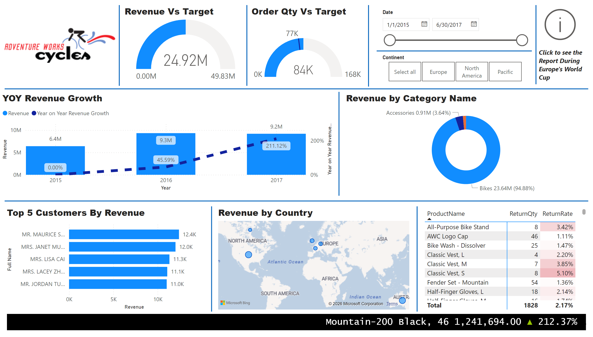
FINAL Report - Top Line Report
Notes:
image
No alt text provided
YOY Revenue Growth
No alt text provided
donutChart
No alt text provided
shape
No alt text provided
shape
No alt text provided
shape
No alt text provided
Top 5 Customers By Revenue
No alt text provided
shape
No alt text provided
map
No alt text provided
shape
No alt text provided
pivotTable
No alt text provided
shape
No alt text provided
Revenue Vs Target
No alt text provided
Order Qty Vs Target
No alt text provided
shape
No alt text provided
shape
No alt text provided
slicer
No alt text provided
slicer
No alt text provided
shape
No alt text provided
ScrollingTextVisual1448795304508
No alt text provided
shape
No alt text provided
actionButton
No alt text provided
textbox
No alt text provided

Slide 3
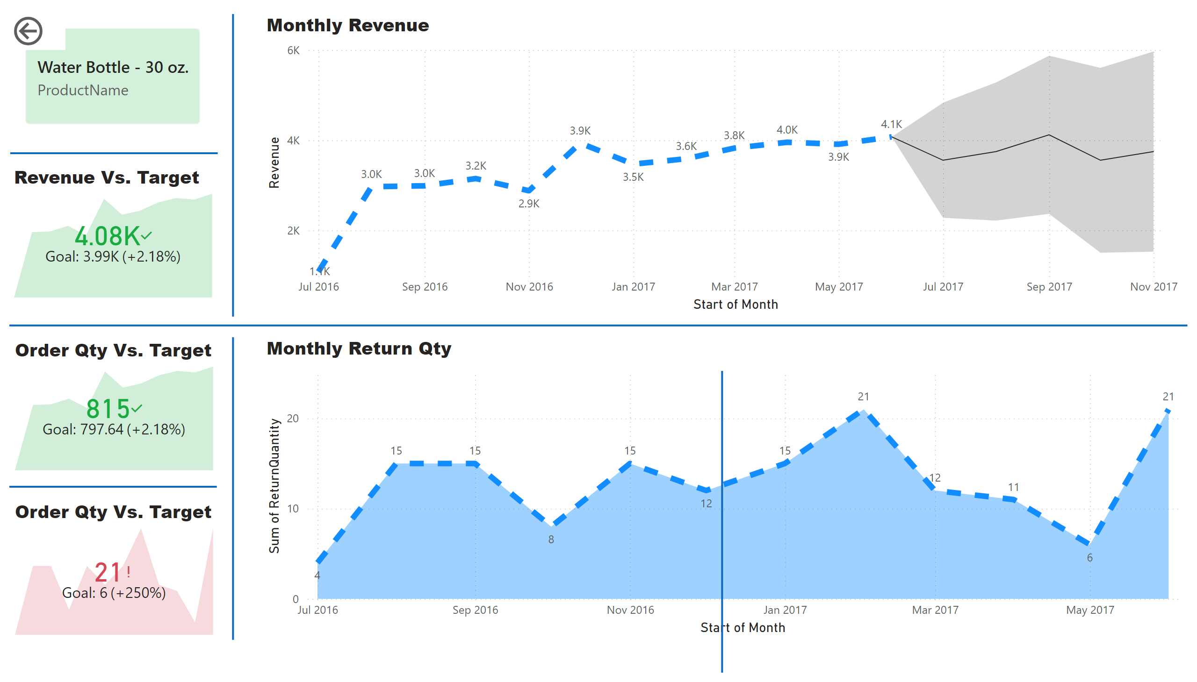
Product Detail
Notes:
Monthly Revenue
No alt text provided
shape
No alt text provided
Monthly Return Qty
No alt text provided
Revenue Vs. Target
No alt text provided
shape
No alt text provided
shape
No alt text provided
Order Qty Vs. Target
No alt text provided
shape
No alt text provided
Order Qty Vs. Target
No alt text provided
shape
No alt text provided
actionButton
No alt text provided
cardVisual
No alt text provided
shape
No alt text provided
slicer
No alt text provided

Slide 4
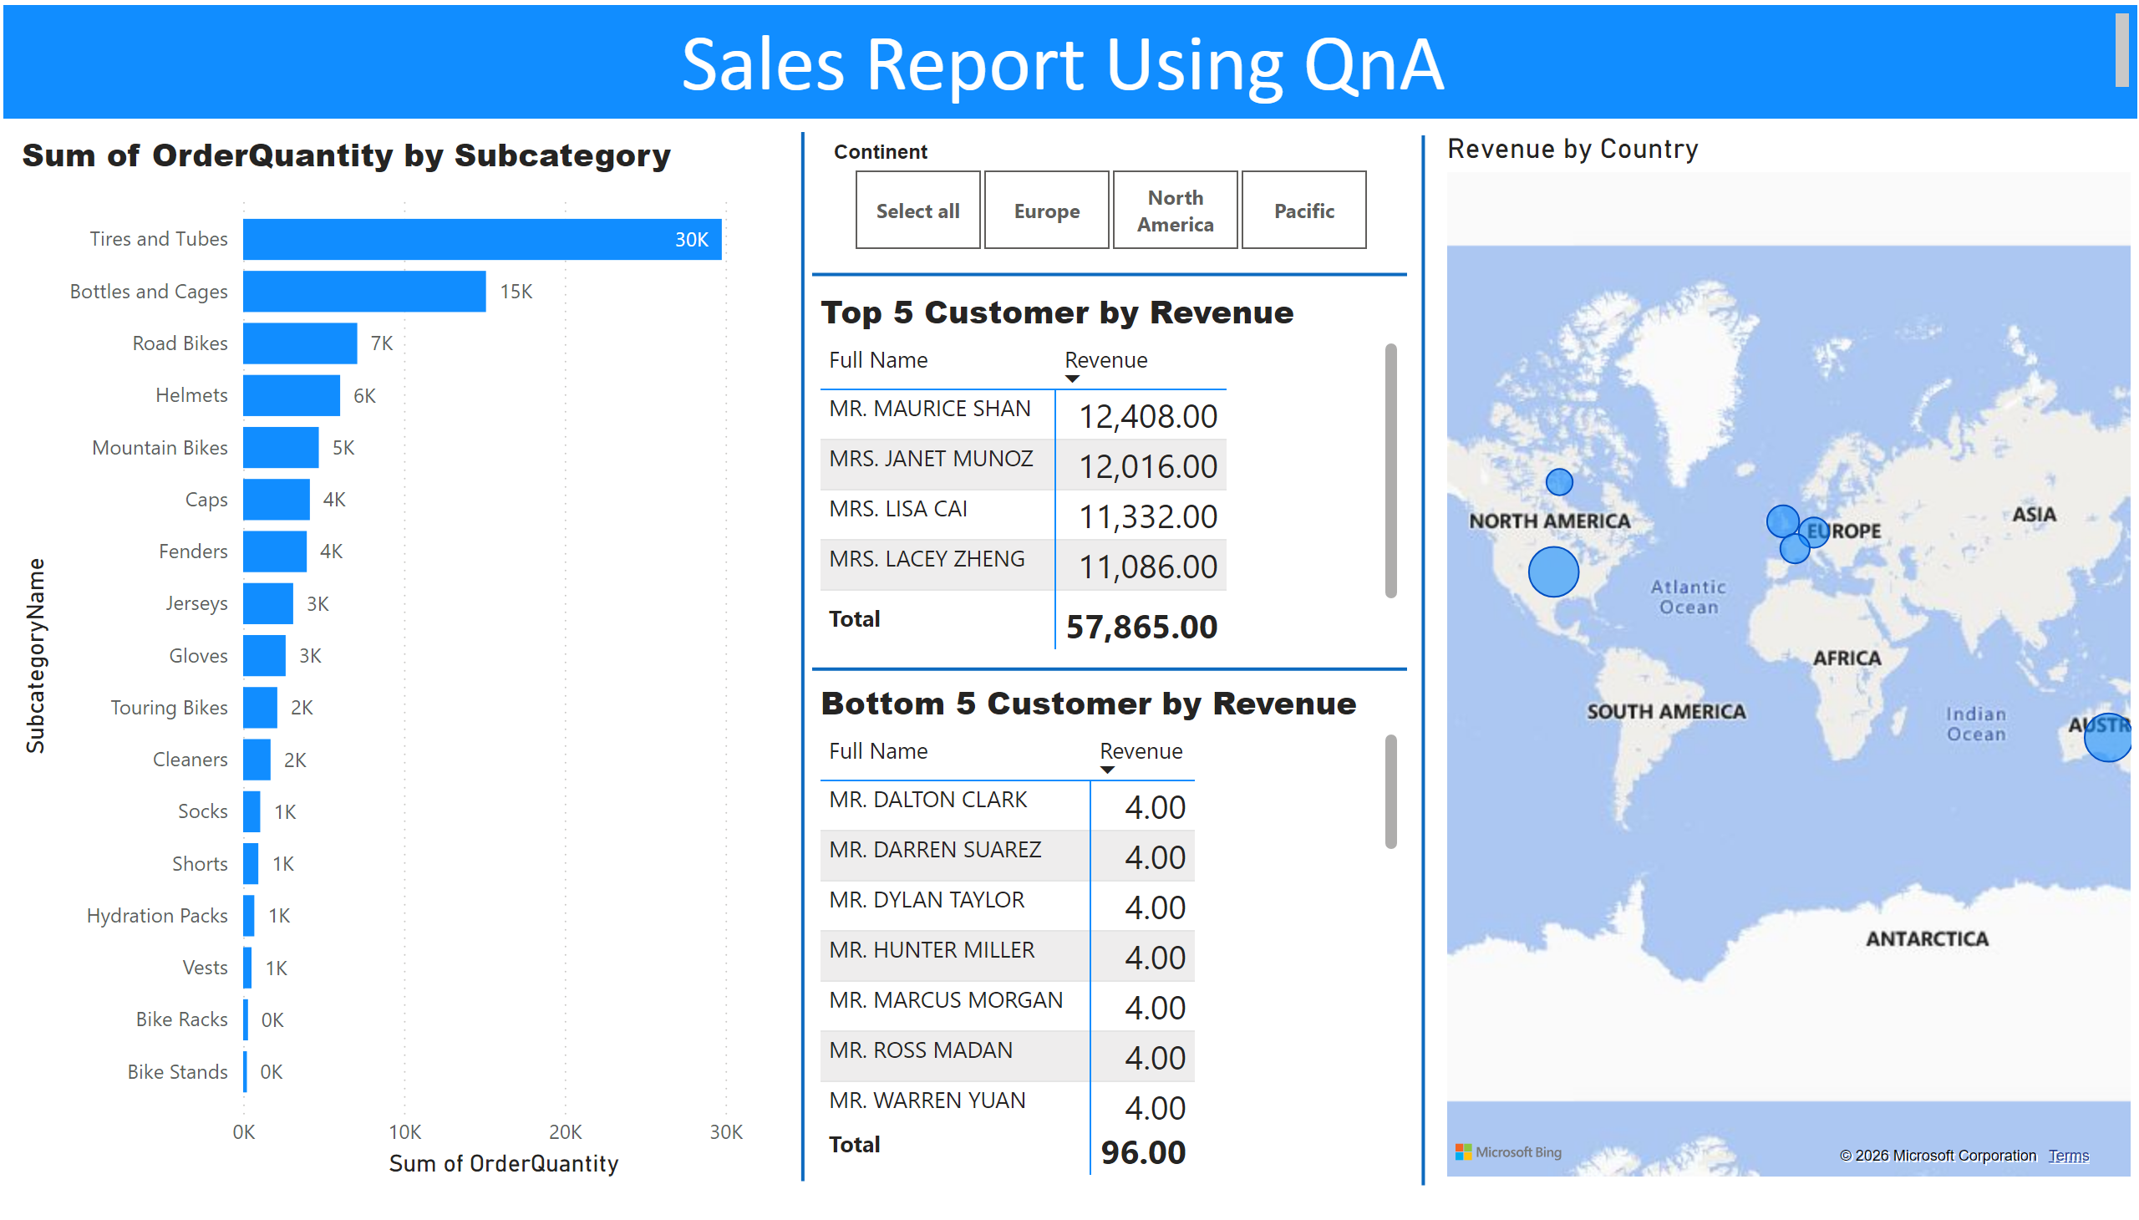
NLQ
Notes:
slicer
No alt text provided
shape
No alt text provided
textbox
No alt text provided
shape
No alt text provided
map
No alt text provided
Bottom 5 Customer by Revenue
No alt text provided
shape
No alt text provided
Top 5 Customer by Revenue
No alt text provided
shape
No alt text provided
Sum of OrderQuantity by Subcategory
No alt text provided

Slide 5
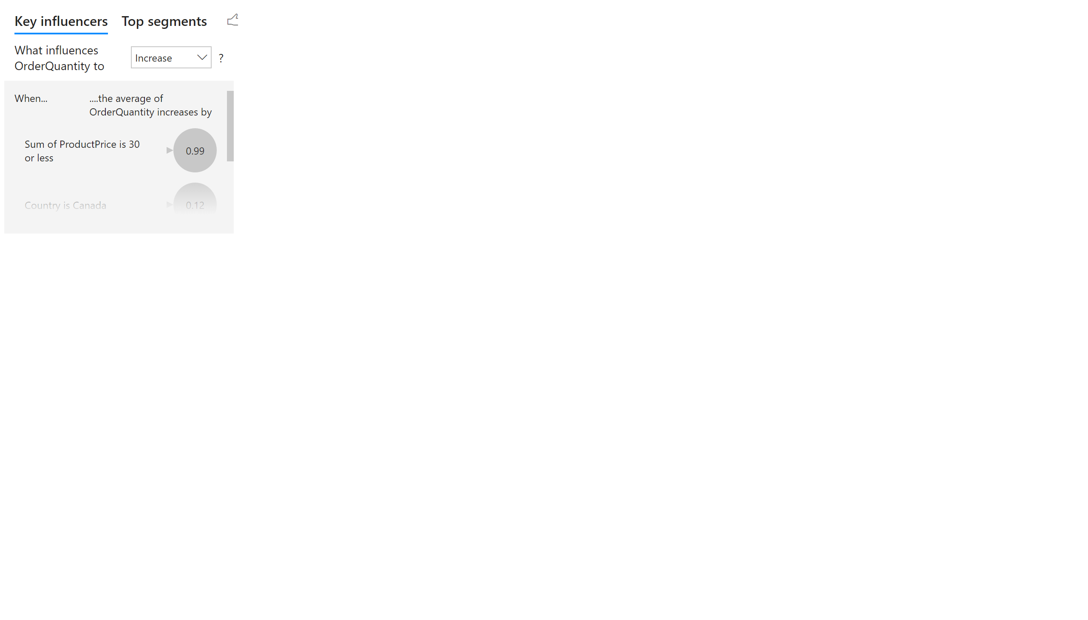
KI
Notes:
keyDriversVisual
No alt text provided

Slide 6
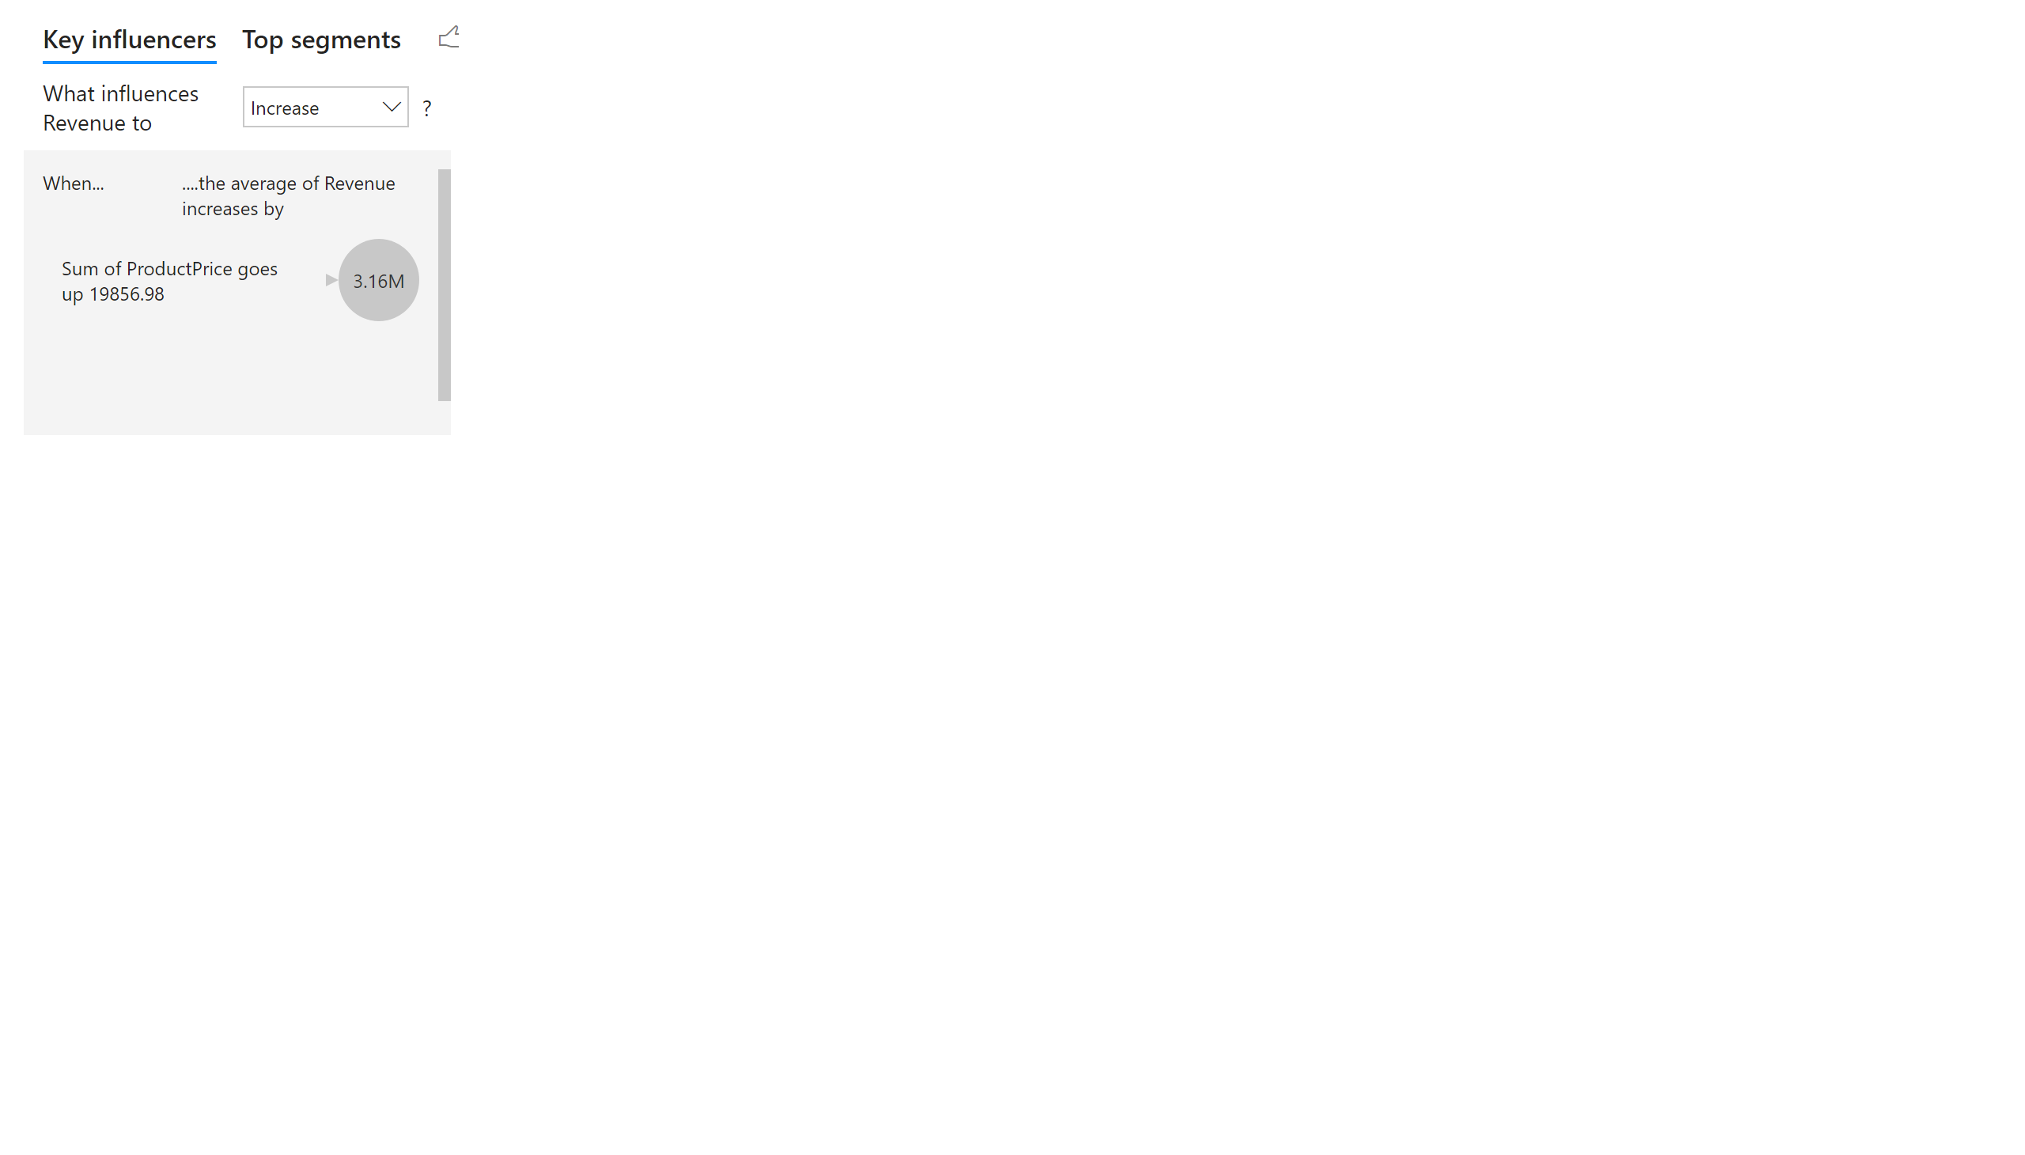
KI 2
Notes:
keyDriversVisual
No alt text provided

Slide 7
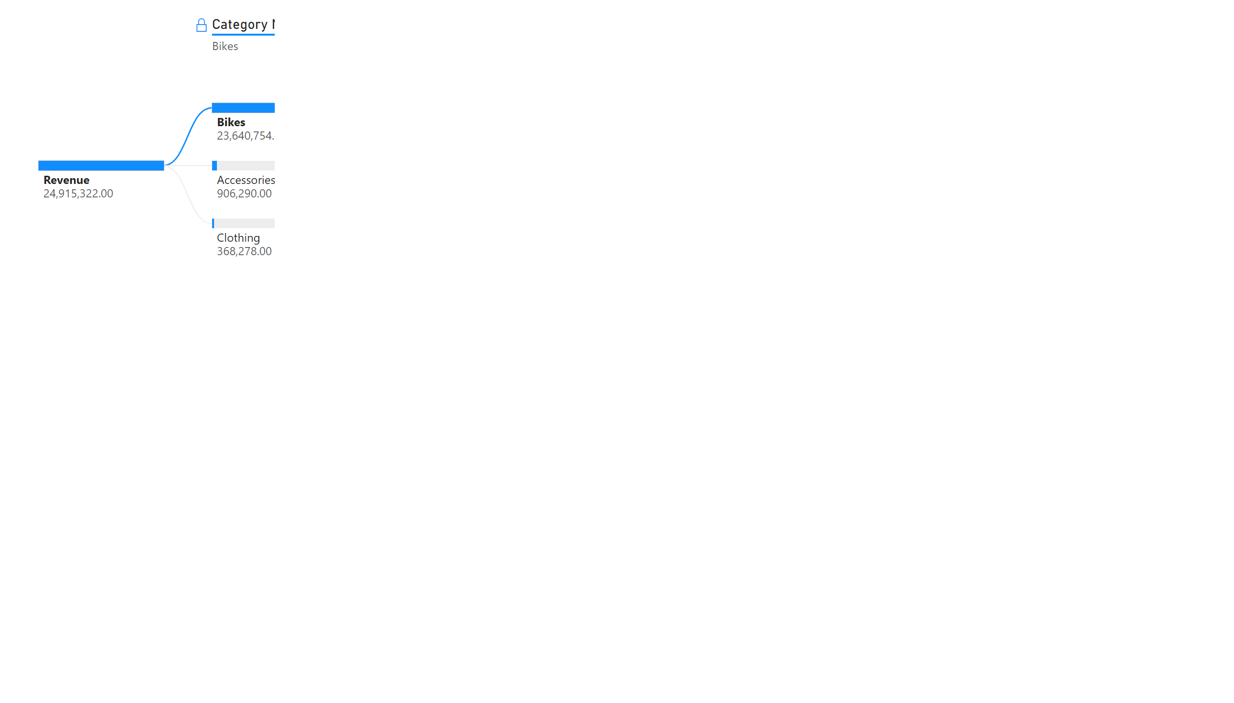
DT
Notes:
decompositionTreeVisual
No alt text provided

Slide 8
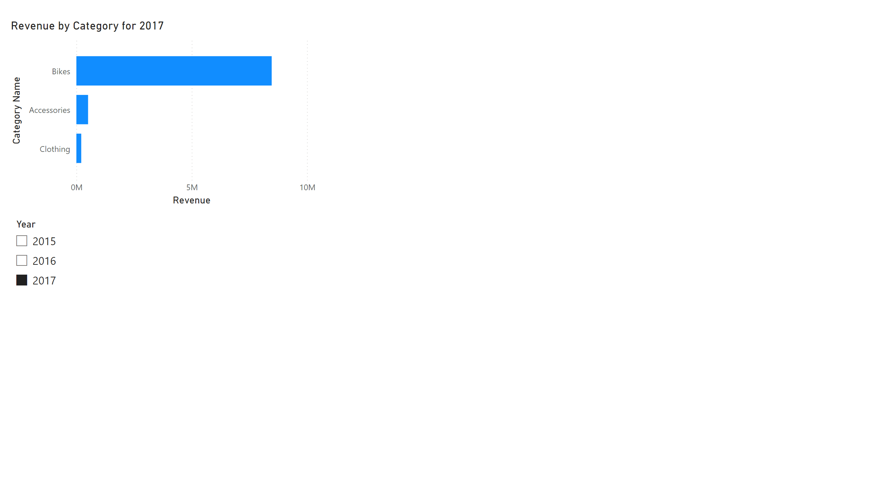
Page 1
Notes:
Revenue by Category for 2017
No alt text provided
slicer
No alt text provided

